Slide 1
AICAS 2021
Washington D.C., USA → Virtual Conference
March 28-30, 2021

Slide 2
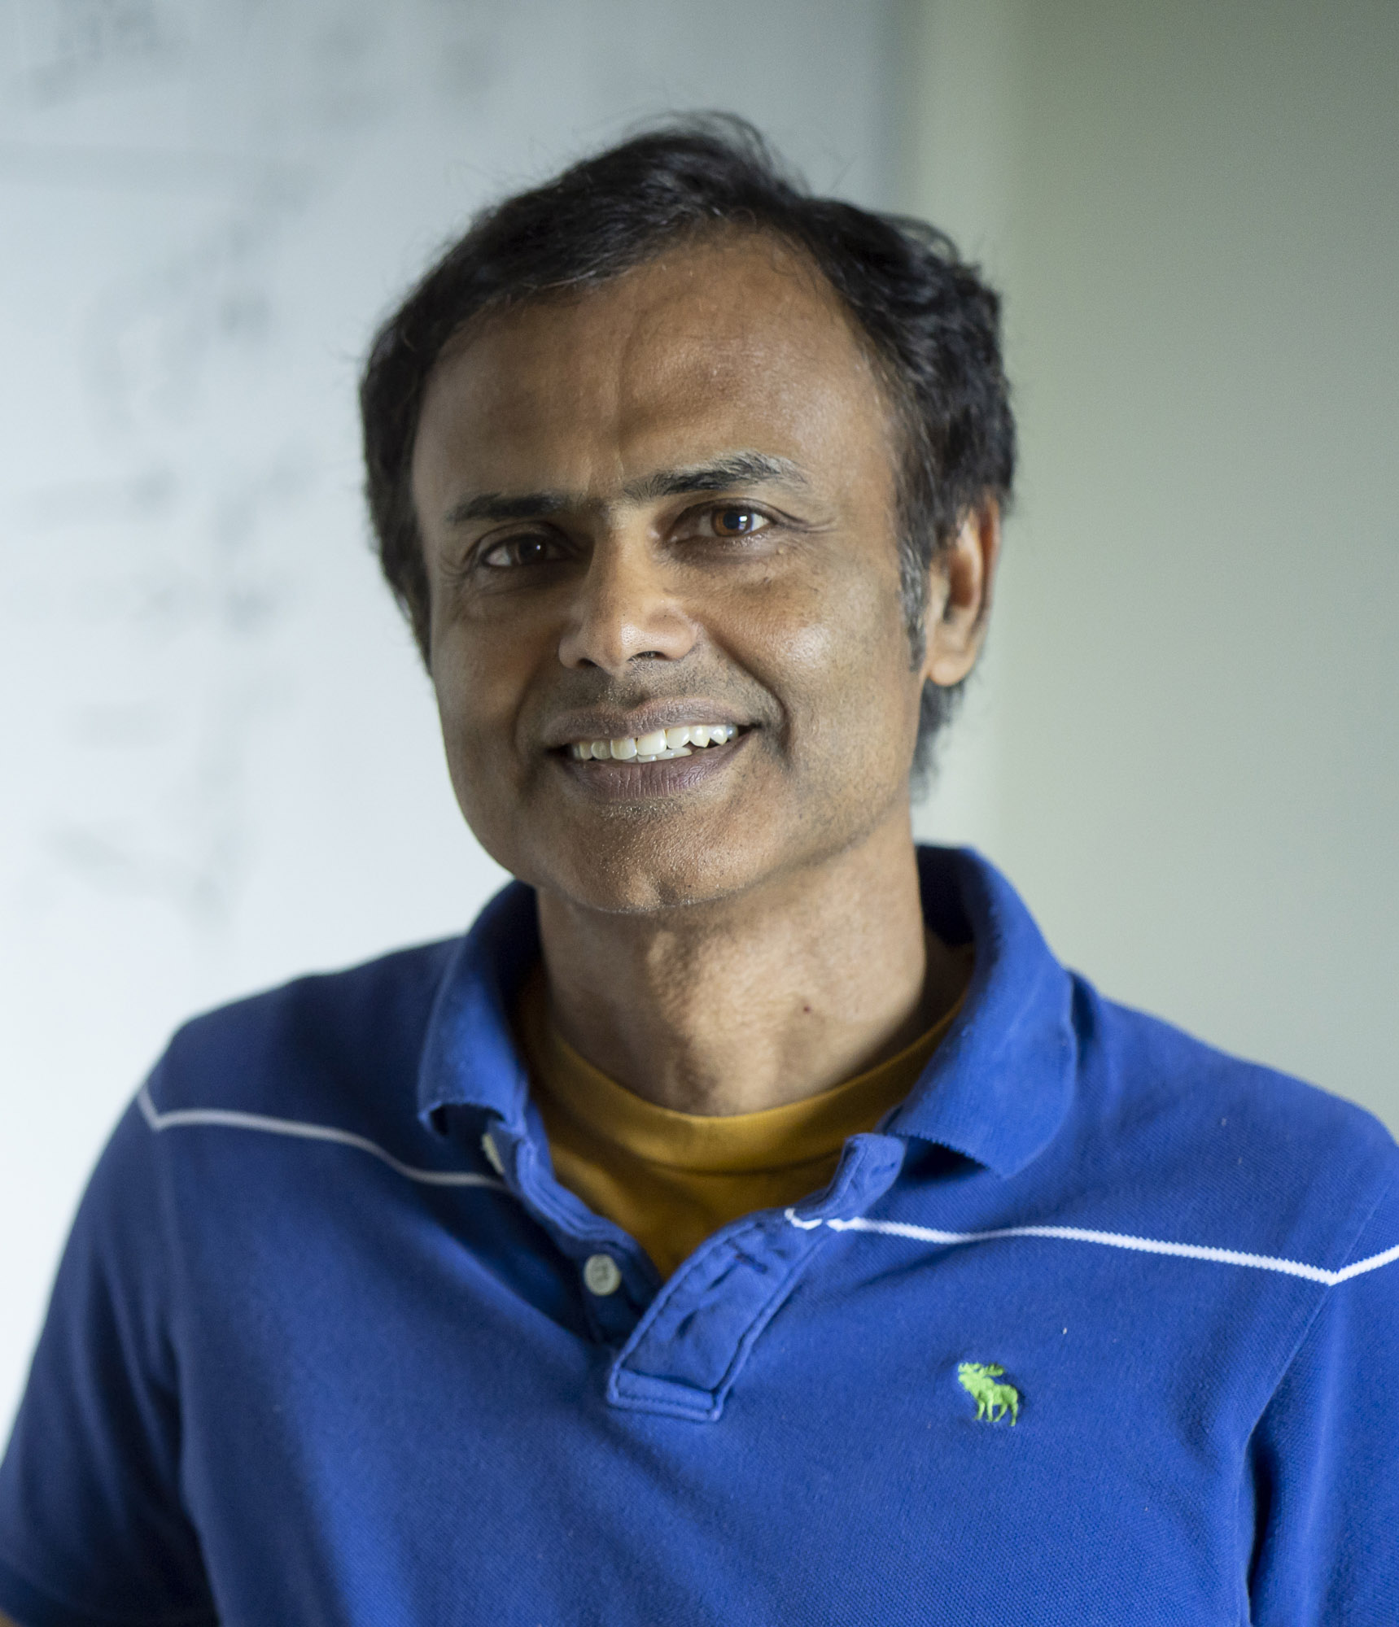
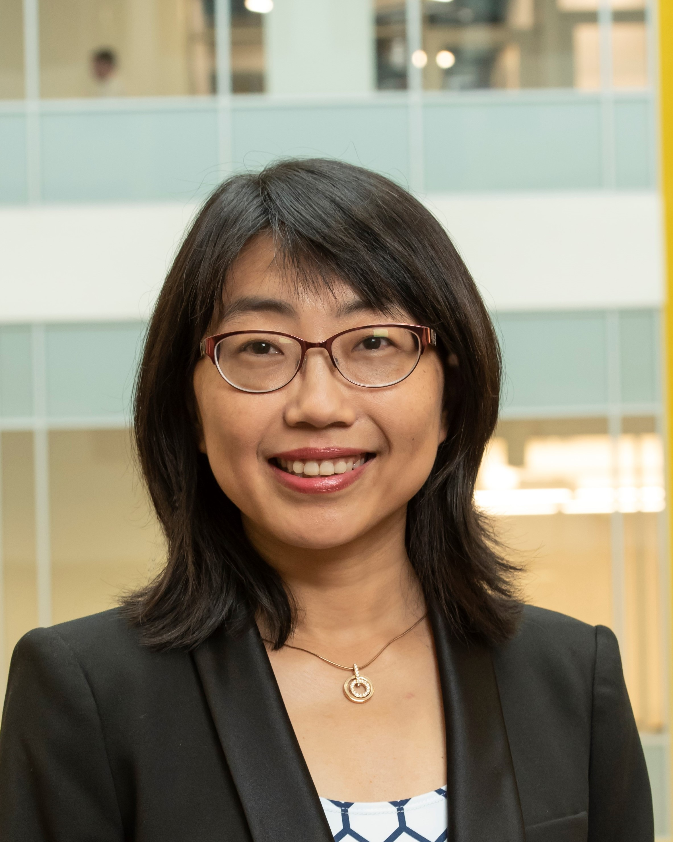
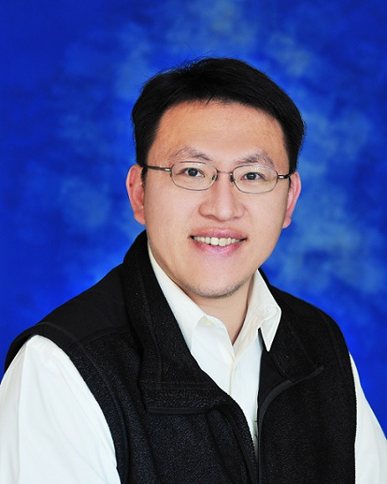
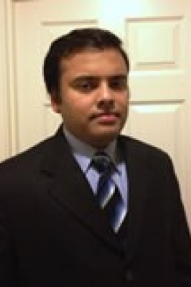
Organization Committee
General Chairs
Technical Program Chairs
Kaushik Roy
Purdue University
Hai “Helen” Li
Duke University
Meng-Fan Chang
National Tsing Hua University
Arijit Raychowdhury
Georgia Institute of Technology

Slide 3
Organization Committee
Special Session Co-chairs
Weisheng Zhao, Beihang Univ.
Sungjoo Yoo, Seoul National Univ.
Emre Meftci, UC Irvine
Ulf Schlichtmann, TUM, Germany
Tutorial Co-chairs
Chris Hyung-il Kim, Univ. of Minnesota
Chia-Lin Yang, National Taiwan Univ.
Takashi Sato, Kyoto Univ.
Hao Yu, Southern Univ. of S&T
Panel Co-chairs
Yiran Chen, Duke Univ.
Shouyi Yin, Tsinghua Univ.
Aida Todri-Sanial, LIRMM, France
Demo Co-chairs
Yung-Hsiang Lu, Purdue Univ.
Jongsun Park, Korea Univ.
Arindam Basu, NTU Singapore
Industrial Session Co-chairs
Jiun-In Guo, National Chiao Tung Univ.
Ambar Sarkar, Nvidia
Exhibition Co-chairs
Jae-sun Seo, Arizona State Univ.
Yongpan Liu, Tsinghua Univ.
Yuan-Hao Chang, IIS, Sinica
Matthew Ziegler, IBM, Zurich
Publication Chairs
Wujie Wen, Lehigh Univ.
Notes:
Local Arrangement Co-chairs
Xiang Chen, GMU
Chenchen Liu, Clarkson Univ.
Deliang Fan, Arizona State Univ.

Slide 4
Organization Committee
Publicity
Sri Parameswaran, Univ. of New South Wales, Australia
Yu Wang, Tsinghua Univ.
Georgios Keramidas, Think Silicon S.A. Mobile Graphic Solutions, Greece
Finance Chair & Secretary
Mattew Novik, Duke Univ.
Advisory Board
Pamela Abshire, Univ. of Maryland, USA
Krishnendu Chakrabarty, Duke Univ., USA
Leland Chang, IBM Watson
Robert Chen-Hao Chang, National Chung Hsing University, Taiwan
Shao-Yi Chien, National Taiwan University, Taiwan
Mike Davis, Intel Corp.
Jörg Henkel, Karlsruhe Institute of Technology, Germany
Giacomo Indiveri, Univ. of Zurich, Zurich
Yong Lian, York University, Canada
Chiao Liu, Facebook
Other IEEE Organizational Units & Entities
IEEE Solid State Circuits Society
TCVLSI under the IEEE-CS
IEEE Council on EDA
WiCAS and IEEE Young Professionals
ACM SIGDA

Slide 5
Timeline
Nov. 1
SS/Tutorial/Demo
proposal
Nov. 29
Submission
extension
Aug. 28
AICAS’20
Sep. 14
CFP
Nov. 15
Paper Submission
March 21
Presentation
Upload
Jan. 31
Camera Ready
March 28
AICAS’21
Feb. 28
Registration (Author)
Jan. 11
Notification

Slide 6
AICAS 2021
2021 AICAS
AICAS
AICAS 2021

